Slide 1

Measuring freezing responses with Deeplabcut
Notes:
Today I’m going to share with you my insights on DEEPLACUT which is growing fast in popularity and how we can use it to detect and measure freezing.

Slide 2
What is Deeplabcut (DLC) ?
DLC is a toolbox used for pose estimation
It is based on pre-trained deep learning models

Slide 3
What is this talk about ?
First, a few suggestions before training the network
Mainly, how to use DLC output to measure freezing
Details for running DLC and training the network can be later discussed
Notes:
I will start first by giving a few advices for preparation before training the network which might save you from a lot of trouble. However, the bulk of the presentation will be about the way we can use DLC’s output to measure freezing.

Slide 4

Know before you go
Read the documentation of DLC
Read the documentation of the analysis software you are about to use
Label the bodyparts according to the analysis software’s prerequisites
Label carefully and use marks
Notes:
When it comes to the labelling, the selection of bodyparts should be based on the prerequisites

Slide 5
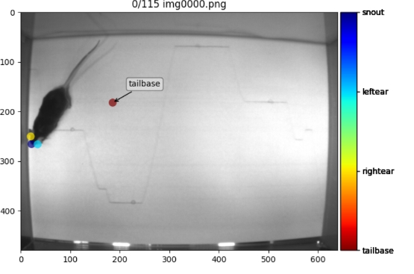
Labeling example

Slide 6
More to Know before you go
Select the proper cameras
• Tradeoff between resolution and distortion during movement (global shutter)
• Frames per second (FPS)
• For Raspberry pi cameras ensure no FPS loss for your desired dimensions
Standardize your experimental settings
• Identical environments (background, brightness etc)
• Fixated positions of cameras (distance from the ground, angle etc)
• Same cameras, same recorders and same resolution settings for both

Slide 7
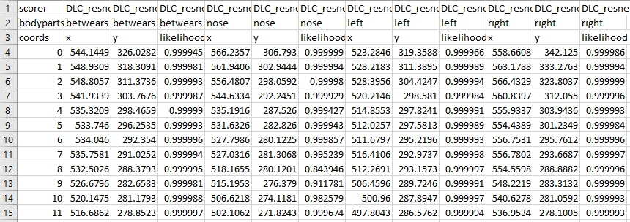
DLC output example

Slide 8
Available software for analysis
BehaviorDEPOT
Possibly other programs (i.e SimBA)
Last but (hopefully) not least, my program

Slide 9
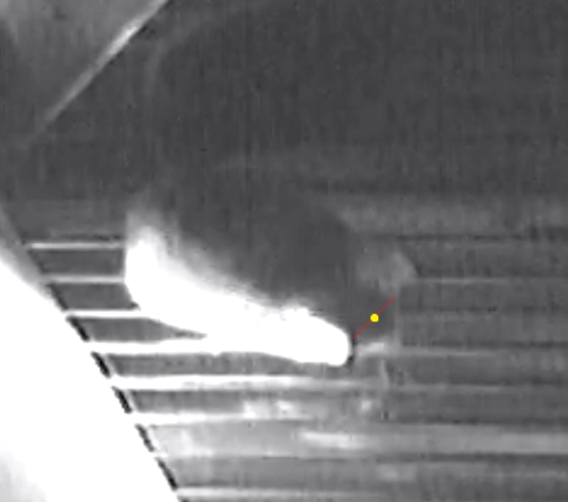
Labeled body parts
Between ears (betwears)
Left ear
Right ear
Nose

Slide 10
Initial thoughts
Focus on betwears
Find series of adjacent frames that have x and y values too close to each other

Slide 11
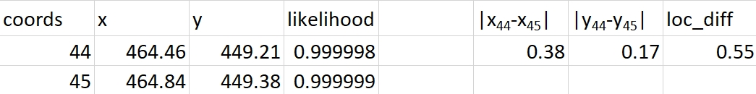
Initial thoughts
Let x axis coordinates of 1st, 2nd … Nth frame x₁, x₂ … x_{N}
Let y axis coordinates of 1st, 2nd … Nth frame y₁, y₂ … y_{N}
Then loc_diff = |x₁ - x₂| + |y₁ - y₂|
i.e loc_diff = |x₄₄ – x₄₅| + |y₄₄ – y₄₅| = 0.55

Slide 12
Initial thoughts
Select videos from many (identical) cameras and many (identical) apparati
Select videos from the testing dataset (not the training one)
Watch them and isolate consecutive freezing frames
Find a cutoff criterion for loc_diff , pass it as a value and you’re done

Slide 13
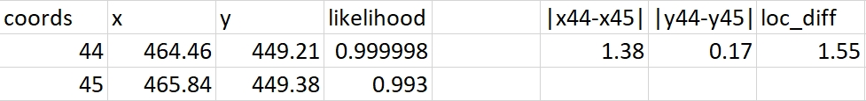
Unfortunately DLC is not perfect (luckily though it knows it)
Let’s assume that after many observations we’ve set loc_diff = 1.5 as cutoff
However, after watching one more recording, two consecutive -verified by eye- freezing frames surpass the cutoff criterion

Slide 14
Correcting for detection variance
We can define detection variance as the variance in x and y values that is dependent on different likelihood estimations of DLC (and not on real differences due to movement)
Then we capitalize on DLC’s uncertainty to linearly interpolate x and y values in low likelihood frames before we calculate loc_diff between adjacent frames.
x=1
y=2
p=0.9999
x=2
y=10
p=0.9999
x=1.1
y=2.8
x=1.2
y=3.6
x=1.3
y=4.4
x=1.4
y=5.2
x=1.5
y=6
x=1.6
y=6.8
x=1.7
y=7.6
x=1.8
y=8.4
x=1.9
y=9.2
p=0.993
p=0.993
p=0.993
p=0.993
p=0.993
p=0.993
p=0.993
p=0.993
p=0.993
p=0.993
p=0.993
p=0.993
p=0.993
p=0.993
p=0.993
p=0.993
p=0.993

Slide 15
Correcting for detection variance
We can define detection variance as the variance in x and y values that is dependent on different likelihood estimations of DLC (and not on real differences due to movement)
Then we capitalize on DLC’s uncertainty to linearly interpolate x and y values in low likelihood frames before we calculate loc_diff between adjacent frames.
x=1
y=2
p=0.9999
x=1.1
y=2.8
x=1.2
y=3.6
x=1.3
y=4.4
x=1.4
y=5.2
x=1.5
y=6
x=1.6
y=6.8
x=1.7
y=7.6
x=1.8
y=8.4
x=1.9
y=9.2
x=2
y=10
p=0.9999
p=0.993
p=0.993
p=0.993
p=0.993
p=0.993
p=0.993
p=0.993
p=0.993
p=0.993
p=0.993
p=0.993
p=0.993
p=0.993
p=0.993
p=0.993
p=0.993
p=0.993

Slide 16
Correcting for detection variance
In principle, we could linearly interpolate all x and y values with a likelihood below a certain cutoff criterion.
However, if the high likelihood (reference) frames are far from each other, the rectification of the values will result in erroneously low loc_diff (False Positives)
Oversmoothed x & y values
x=1
y=2
p=0.9999
x=2
y=10
p=0.9999
p=0.993
x 99

Slide 17
Correcting for detection variance
To avoid oversmoothing x and y values we have to define an accepted range with left and right cutoff “low” likelihood values which will be interpolated.
This short-ranged interpolation helps us increase True Positives (real freezing that’s detected as such) and decrease False Positives (motion erroneously detected as freezing)

Slide 18
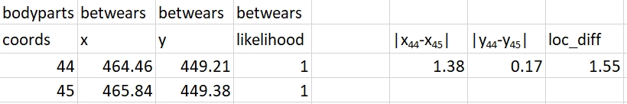
Dealing with the overconfident aspect of DLC
Sadly, sometimes DLC makes mistakes but it’s stubbornly sure about its rightness.
Let’s assume that
loc_diff = 1.5
we have visually detected freezing between frame 44 and frame 45.

Slide 19

Dealing with the overconfident aspect of DLC
Intuitively, you’d consider re-adjusting the loc_diff to fit the new observations.
Notes:
Create more problems than solving ones. I found myself trying to combat a problem that was seemingly insoluble. Much like Hercules when he was fighting Lernan Hydra. The similarities between me and Hercules might not be blatant (although we both are … long-haired), but we really shared something in common. In case of Hercules, every time he would…

Slide 20
Dealing with the overconfident aspect of DLC
Fortunately, erroneous overconfident observations are usually not consecutive.
Instead of looking solely in the x and y axis differences between two consecutive frames, we can also calculate the differences in x and y values between the following frames.
F₁
F₂
F₃
F₄
F₅
x = 464.46
x = 465.84
x = 464.89
x = 464.23
x = 464.35
|x₁-x_{2|} = 1.38
|x₂-x_{3|} = 0.95
|x₃-x_{4|} = 0.57
|x₄-x_{5|} = 0.12

Slide 21
Dealing with the overconfident aspect of DLC
Fortunately, erroneous overconfident observations are usually not consecutive.
Instead of looking solely in the x and y axis differences between two consecutive frames, we can also calculate the differences in x and y values between the following frames.
F₁
F₂
F₃
F₄
F₅
x = 464.46
x = 465.84
x = 464.89
x = 464.23
x = 464.35
x₂-x₁ = 1.38
x₃-x₂ = -0.95
x₄-x₃ = -0.66
x₅-x₄ = 0.12

Slide 22
Dealing with the overconfident aspect of DLC
|(x₂-x₁) + (x₃-x₂) + (x₄-x₃) + (x₅-x₄)| = |1.38 - 0.95 - 0.66 + 0.12|= 0.11
/4 = 0.027
Fortunately, erroneous overconfident observations are usually not consecutive.
/4 = 0.052
|(y₂-y₁) + (y₃-y₂) + (y₄-y₃) + (y₅-y₄) | = |0.17 - 0.32 + 0.14 – 0.2| = 0.21
+
0.079
Instead of looking solely in the x and y axis differences between two consecutive frames, we can also calculate the differences in x and y values between the following frames.
We can call this result avged_diff (averaged differences). Given that movement can’t possibly last for only 1/25th of a second, avged_diff corrected for the wrong prediction of DLC in x₂ (465.84).
F₁
F₂
F₃
F₄
F₅
x = 464.46
y = 449.21
x = 465.84
y = 449.38
x = 464.89
y = 449.06
x = 464.23
y = 449.2
x = 464.35
y = 449
y₄-y₃ = 0.14
x₅-x₄ = 0.12
x₃-x₂ = -0.95
x₄-x₃ = -0.66
y₅-y₄ = -0.2
x₂-x₁ = 1.38
y₃-y₂ = -0.32
y₂-y₁ = 0.17

Slide 23
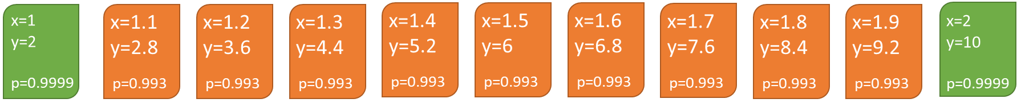
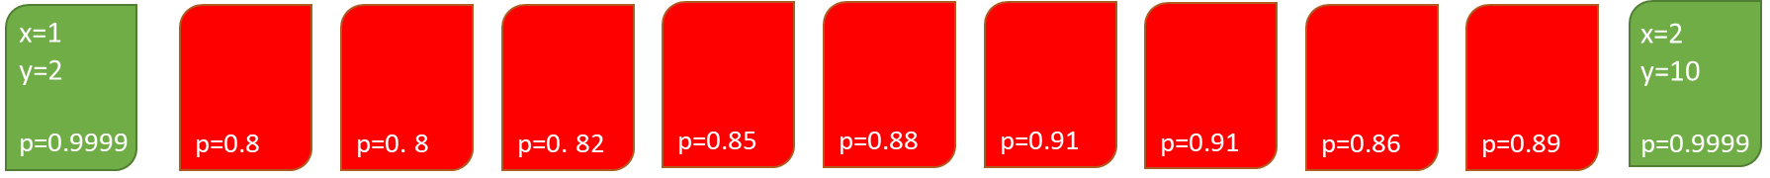
Some freezing was still eluding
This could be caused by :
Low likelihood frames with high detection variance that were not interpolated (likelihood lower than the accepted range)

Slide 24
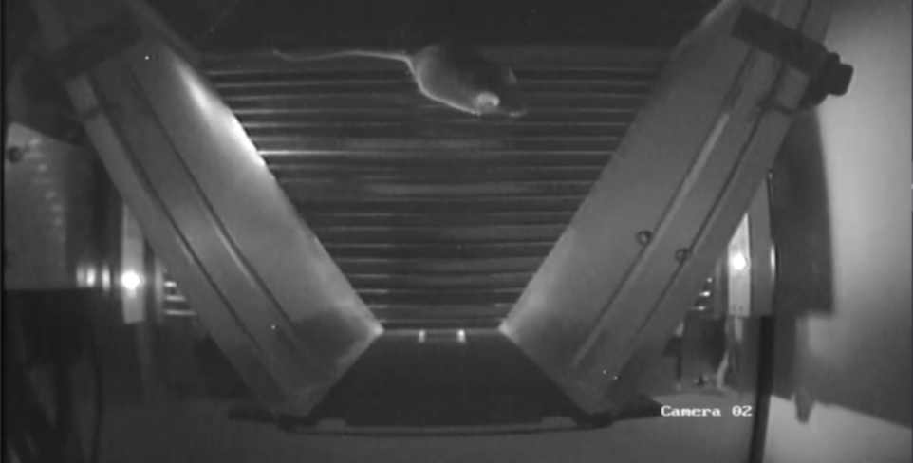
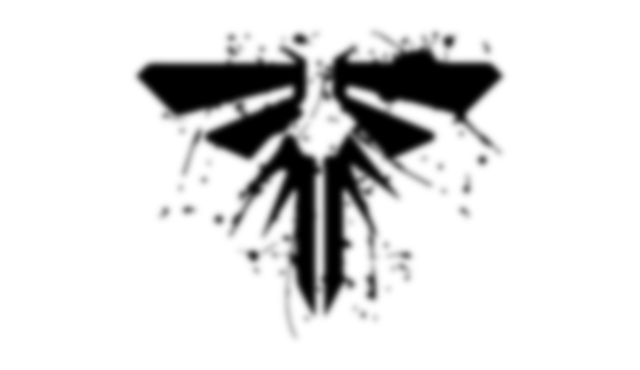
When you’re lost in the darkness look for the light

Slide 25
Adding a second body part for detection
Assessing the loc_diff and avged_diff for the right ear rescued some observations that were not captured by betwears when the mouse’s snout was opposite to the light source
Overlaps of freezing frames based on right ear and betwears were excluded
Freezing detection based on right ear had a complementary role

Slide 26
A solution for False Positives in front of our nose
All series of freezing frames are then further tested based on nose movement
Similar parameters (loc_diff,avged_diff) are used for nose movement detection
If nose movement has been detected and the detection likelihood of the nose across freezing frames is high, then the freezing series is excluded

Slide 27
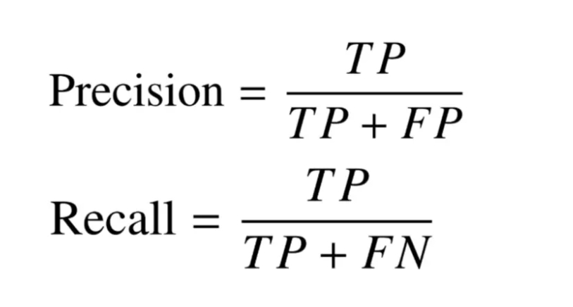

Evaluating the script
48 series of freezing frames and 3 scorers
F1 = 0.907

Slide 28
Thanks!
Carolina Temporão
Marloes Henckens
Josephine Bouman
Sabrina van Heukelum
Ema Lopes
Nishant Joshi

